Slide 1


Making space
Improving London’s streets for walkers and wheelers
October 2025

Slide 2



Background
Objectives
Streets are a vital part of London’s transport network. Every day, 6.7 million trips are made by walking or wheeling, accounting for 25.8 percent of all journeys in the city.
However, street conditions are not meeting public expectations, and barriers to safe and accessible travel remain widespread.
London TravelWatch has commissioned Yonder Consulting to conduct research to understand what people need from their streets and how improvements should be prioritised.
The findings will shape London TravelWatch’s work and help advocate for safer, more accessible, and better-quality streets.
Refresh understanding of public priorities for London’s street space
Explore differences in views by location and demographic groups, including people with disabilities, families, and older adults
Assess public support for potential solutions to street-related challenges

Slide 3
Methodology
Qualitative research
2. Quantitative survey
Gathering strategic insights from stakeholders
Understanding Londoners’ walking and wheeling experiences
4x 30-minute online interviews with London TravelWatch’s key stakeholders in the urban planning, transport and civil infrastructure sector.
These interviews helped to:
• Identify strategic priorities and pain points across the transport and urban mobility system.
• Understand what policy-makers and advocacy groups see as key gaps in Londoners' street experiences.
• Surface hypotheses and dimensions to test in the quantitative survey.
• Align survey content with emerging policy, infrastructure priorities, and
lived reality.
Analysis was then conducted to pull out key themes and findings to inform the survey at both the overall and subgroup level (e.g., people with disabilities, families with young children, inner and outer London), where relevant, to highlight nuances in experience.
A 15-question survey conducted with 1,003 Londoners aged 18+ via Yonder’s online London Omnibus.
• Fieldwork was conducted between 4th and 9th July 2025.
• Quotas set on London region, age, ethnicity and gender.
• Post-field weighting on the London population’s age, gender, region, ethnicity, working status and home ownership.
• Data was overlaid with the Index of Multiple Deprivation which is a composite measure of relative deprivation across income, employment, education, health, crime, housing and environment to explore how experiences vary by socio-economic need.
Analysis has been conducted at both an overall and subgroup level, calling out significant differences (at 95 percent confidence).

Slide 4
Key findings
Walking is integral to daily life in London
Satisfaction with walking/ wheeling is high, but some face more barriers
Accessibility and space gaps persist across London’s streets
Walking is the most common way Londoners get around. Two-thirds walk regularly, and is particularly common among younger, wealthier, and ethnically diverse Londoners. In the past six months, 12% of Londoners have wheeled using wheelchairs, mobility aids, or buggies with higher rates among parents, people living in Central London, and those with eyesight conditions. One in four Londoners carry additional items such as pushchairs, trolleys, or luggage, with this being most common among disabled people, parents, and those in Inner London.
Three in five are satisfied with their overall experience walking/wheeling in London, but older people, parents and those with physical conditions are more likely to be dissatisfied. Poor pavement conditions, crowding and safety concerns are the biggest causes of dissatisfaction. These issues disrupt everyday journeys, particularly for those with additional needs.
While two in three find London’s streets easy to navigate, many feel they don’t work for everyone. Just 38% agree the streets are accessible for disabled people, and those with physical conditions are twice as likely to say there is a lack of rest points, safe crossings and accessible infrastructure. Three in five Londoners also feel there’s too much competition for space between walkers, cyclists and other road users.
Safety and confidence drop after dark
Crowding, noise and physical barriers affect many journeys
Pavements, rest stops and toilets are top investment priorities
Most Londoners feel comfortable and safe walking or wheeling during the day. However, two in five feel unsafe walking alone at night, and over half say London’s streets can feel overwhelming or stressful. These concerns are especially pronounced among women and people with physical or mental health conditions.
Well-lit streets, good pavements and green spaces are seen as the top priorities for making London’s streets work well, but dissatisfaction is highest for pavement quality, toilet access and pedestrian congestion. These areas, alongside safer crossings and more rest points, top funding priorities, particularly among older and disabled Londoners. While public transport dominates long-term investment preferences, walking and wheeling are clearly viewed as a core part of London’s transport future.
Crowded pavements, noise, and physical obstacles are the most frequently reported issues, and two in five Londoners have experienced a disruption to their journey in the past month. Access barriers, such as missing or uneven pavements and a lack of toilets are especially common among disabled and older people. Parents and those in deprived areas are more likely to cite crowded pavements as a key barrier.

Slide 5
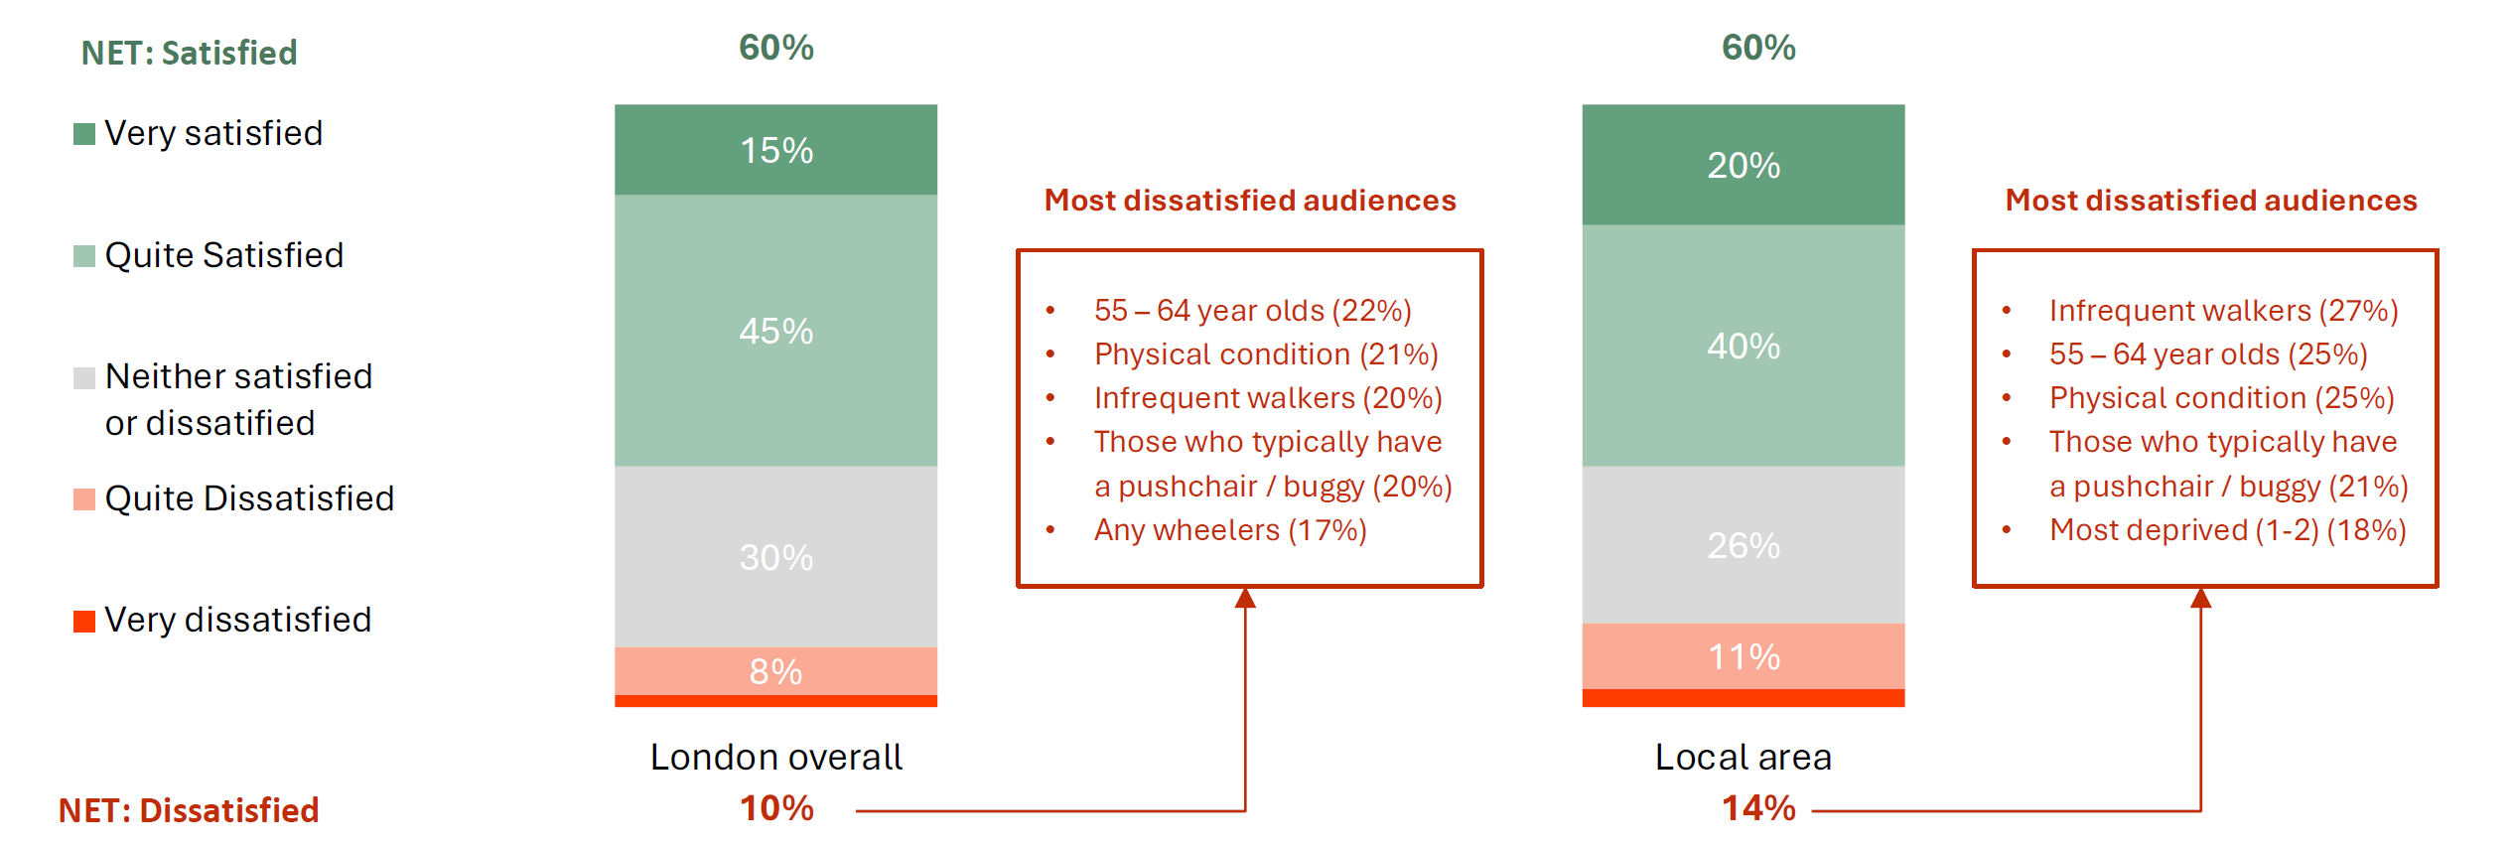
Overall satisfaction with walking / wheeling in London
Three in five Londoners are satisfied walking/wheeling, though older people, Londoners with physical conditions and those with young children are more likely to be dissatisfied

Slide 6
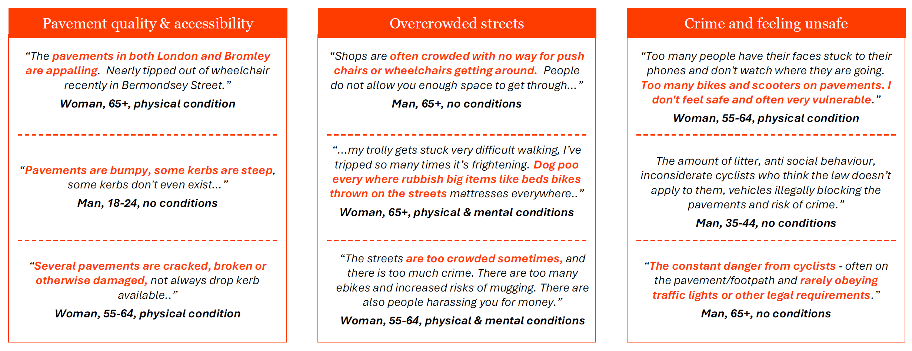
Reasons why dissatisfied with overall walking / wheeling experience in London
Poor pavement conditions, crowding and feeling unsafe are causing dissatisfaction, especially
among older Londoners and those with physical or mental conditions

Slide 7
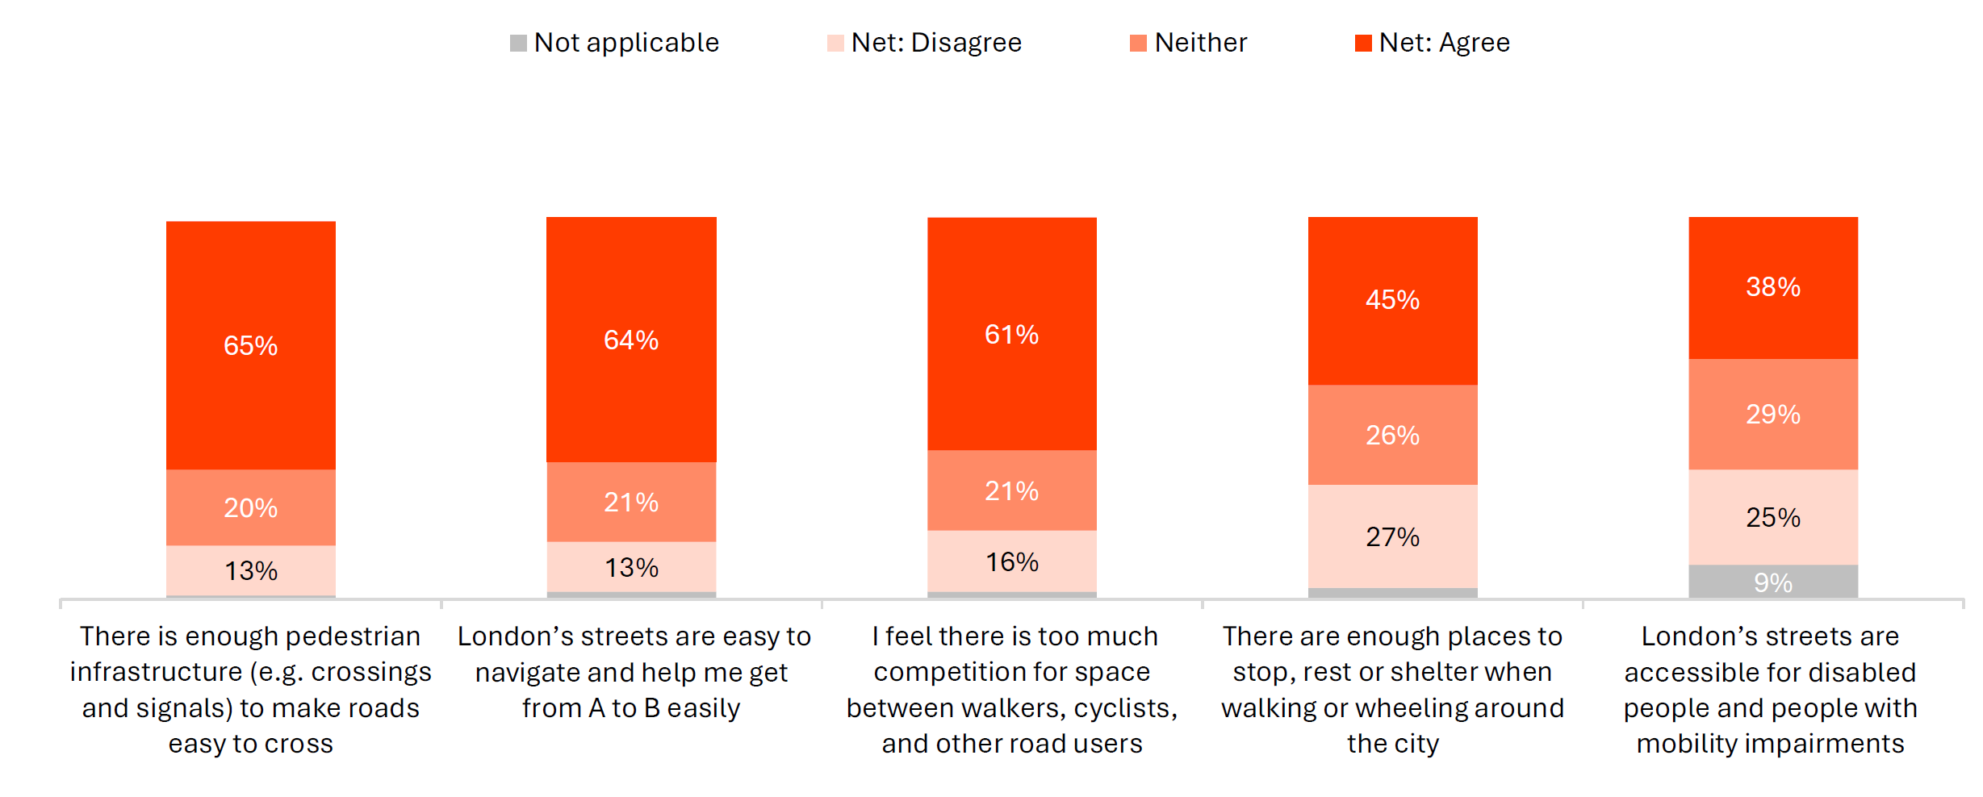
Attitudes towards physical environment and accessibility – Total sample
Two in three find London’s streets easy to navigate, but fewer agree they’re accessible for disabled people or offer enough places to rest. Three in five also feel there’s too much competition for space

Slide 8
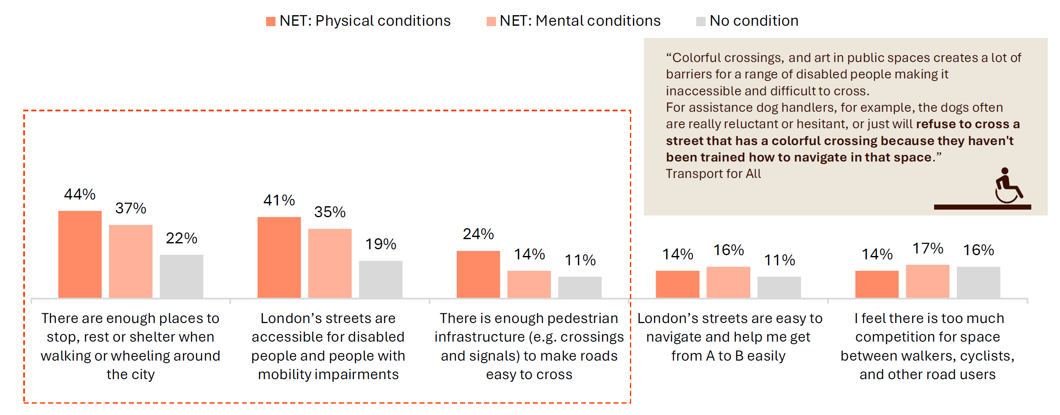
“
Attitudes towards physical environment and accessibility – by condition
Londoners with a physical condition are twice as likely to say streets lack rest points, accessibility
and safe crossings compared to those with no conditions
Colourful crossings and art in public spaces creates a lot of barriers for a range of disabled people making it inaccessible and difficult
to cross.
For assistance dog handlers, for example, the dogs often are really reluctant or hesitant, or just will refuse to cross a street that has a colourful crossing because they haven’t been trained how to navigate in that space.
Transport for All

Slide 9
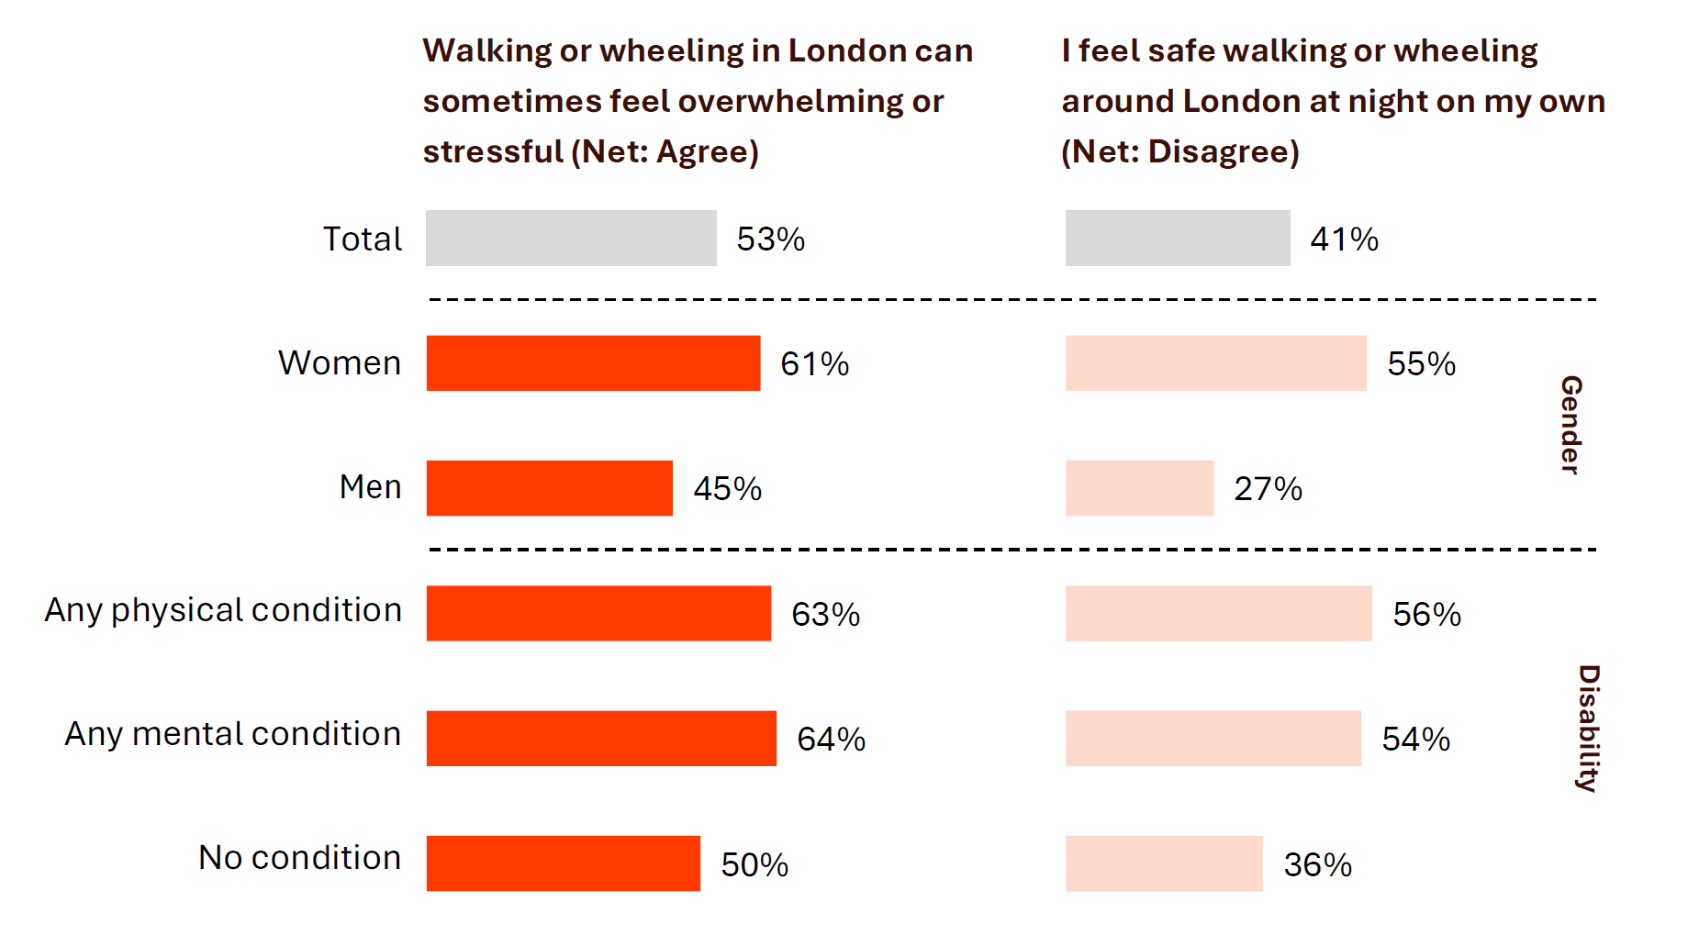
“
Attitudes towards safety and confidence by gender and disability
Stress and night-time safety concerns are significantly higher for women and those with physical or
mental health conditions
Safety is a key concern, and some
people just don't feel safe walking –
particularly at some parts of the day,
and some particular populations.
Give people the confidence and remove
the barriers around being able to travel
actively.
London Councils

Slide 10
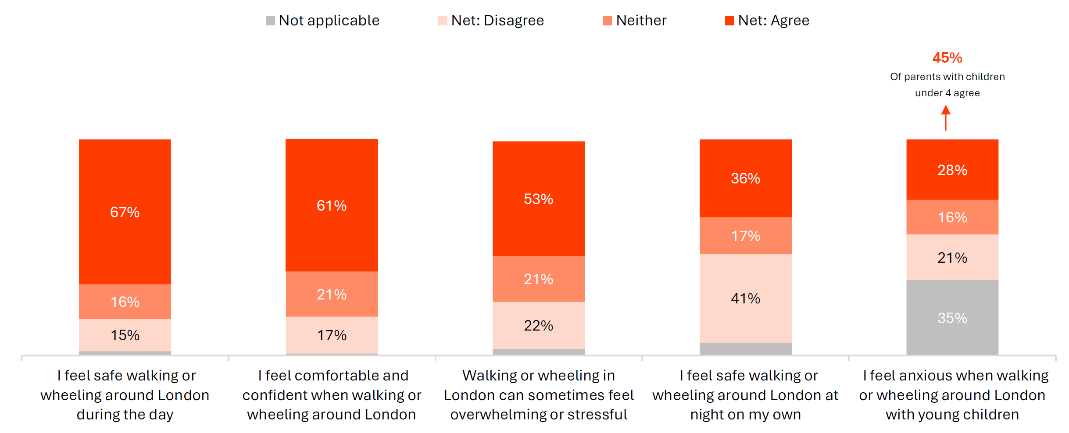
Attitudes towards safety and confidence – Total sample
Two in three feel safe walking/wheeling around London during the day, but safety at night is a concern for two in five. Half also find the streets overwhelming or stressful

Slide 11
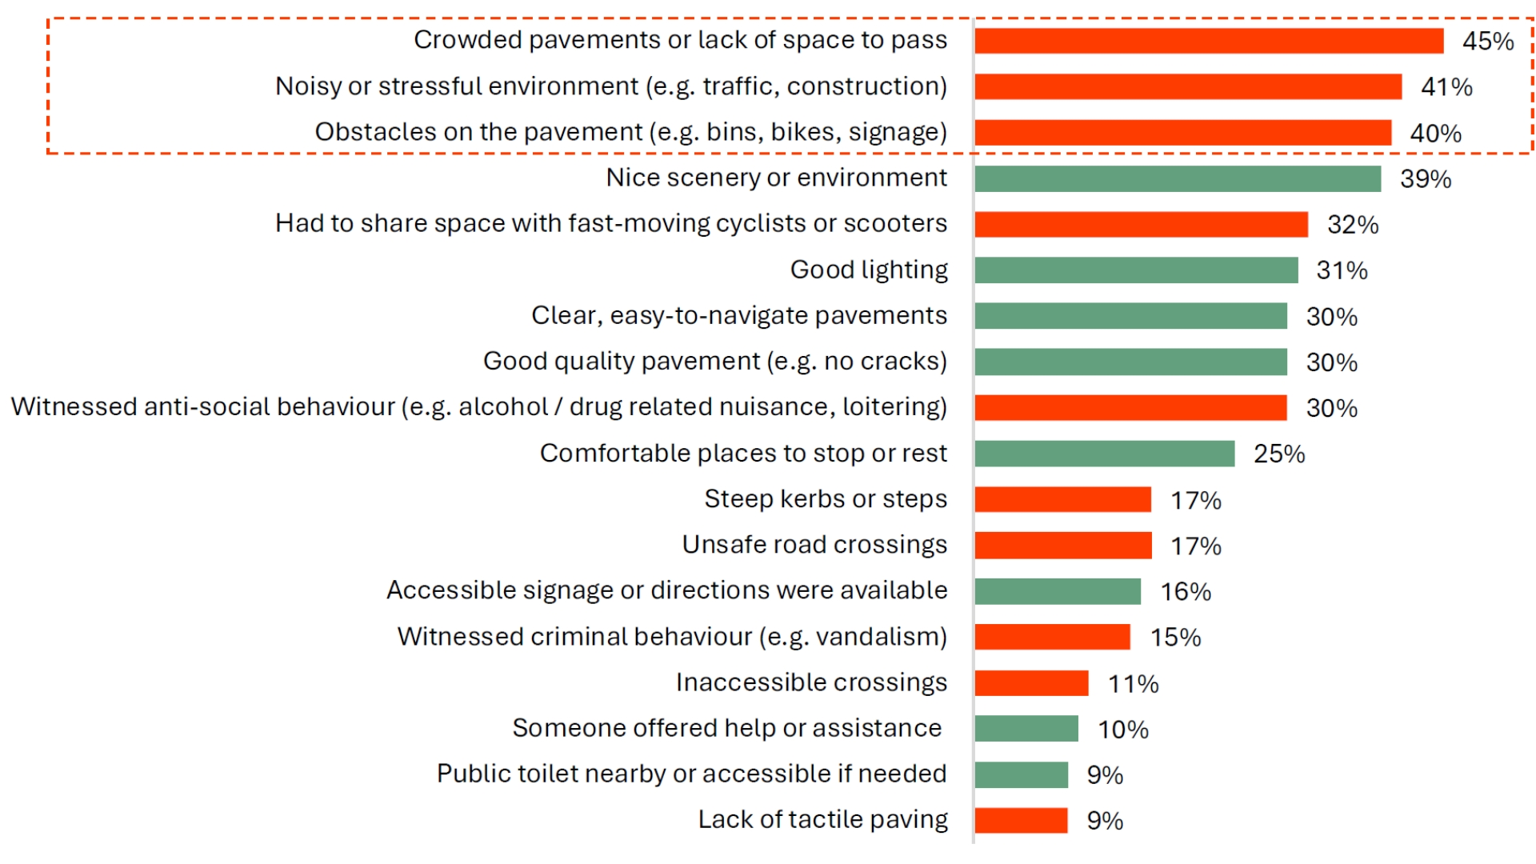

“
Overall experience walking / wheeling in London in the past month
In the past month, the most common walking/wheeling experiences in London involved crowded
pavements, noise and physical obstacles
We found that busy stations,
or areas of London that have really
busy stations or interchanges,
can be extremely overwhelming
and stressful for a lot of
disabled people.
Transport for All
“
Lack of kerbside space and crowding, particularly around the high streets in inner London, but also in outer London is a real challenge.
A nice walking space means actually having space to walk and having enough space so a wheelchair or buggy can pass you. But often the kerbside is not big enough.
London Councils

Slide 12
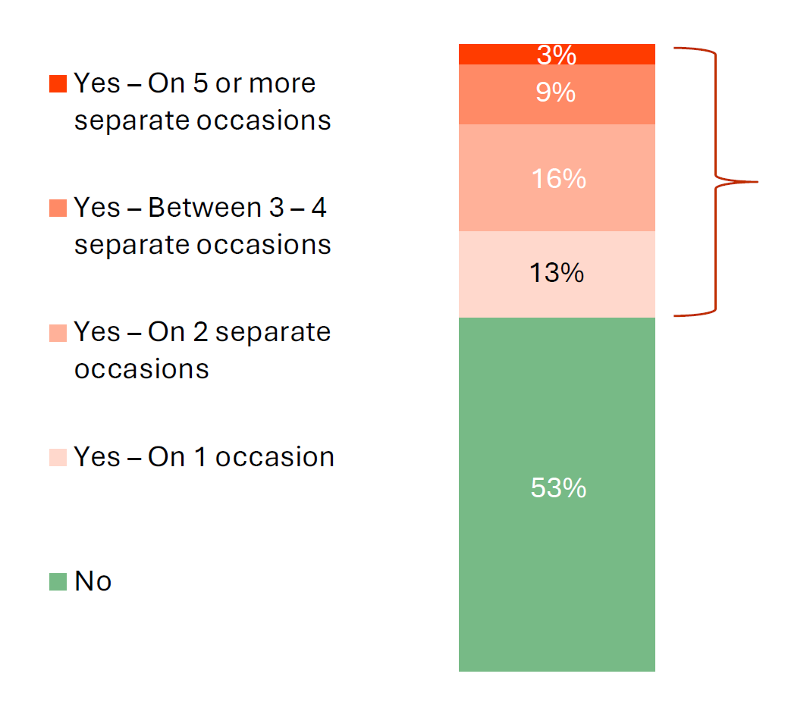
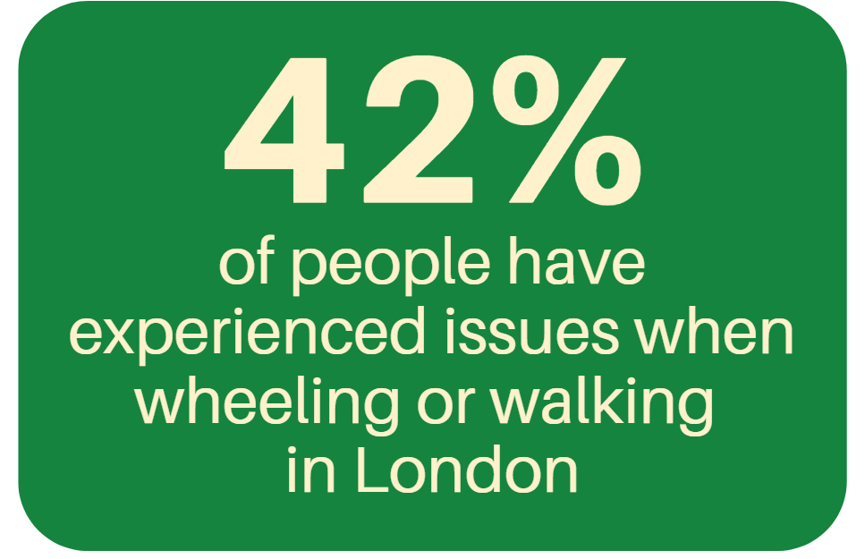
Experienced an issue walking / wheeling in London in the past month
Two in five have experienced issues walking/wheeling in London in the past month, especially those
carrying items, with physical of mental conditions, and parents
More likely to be:
Carrying additional items (63%)
Physical condition (57%)
Mental condition (57%)
Parents (51%)
Inner London (48%)
“
We hear quite a lot about things like e-bikes and e-scooters, or other e-vehicle rental schemes blocking street space, which is a huge physical barrier.
When a disabled person, like a wheelchair user or an assistance dog handler has to double back on themselves and maybe go in the road to avoid that, it's a huge safety concern.
London Councils

Slide 13
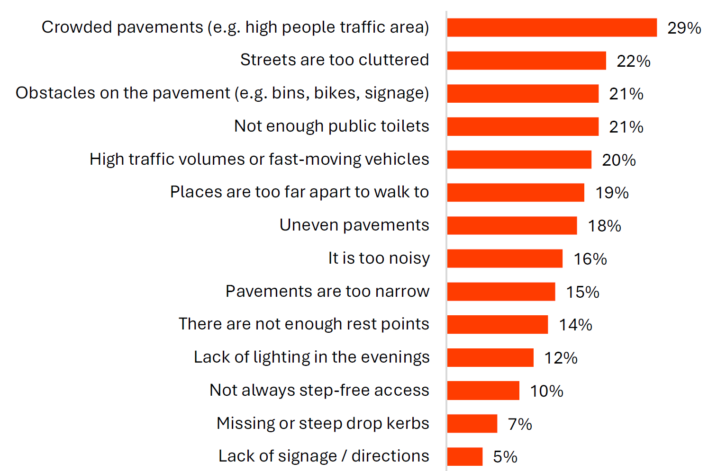
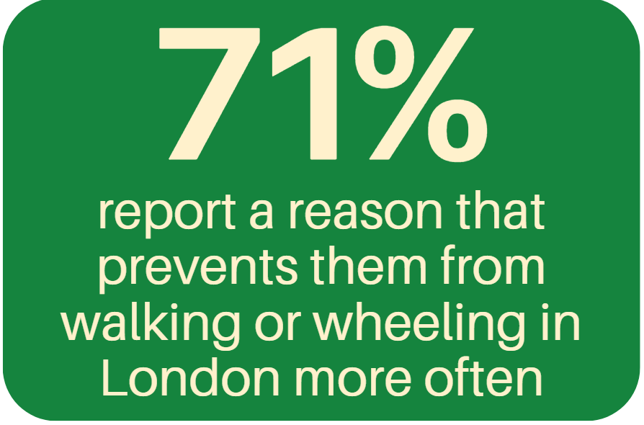
Reasons preventing more frequent walking / wheeling in London – Select up to 5
Seven in ten Londoners cite a reason that stops them walking/wheeling in London more often, with crowded pavements the most common barrier

Slide 14
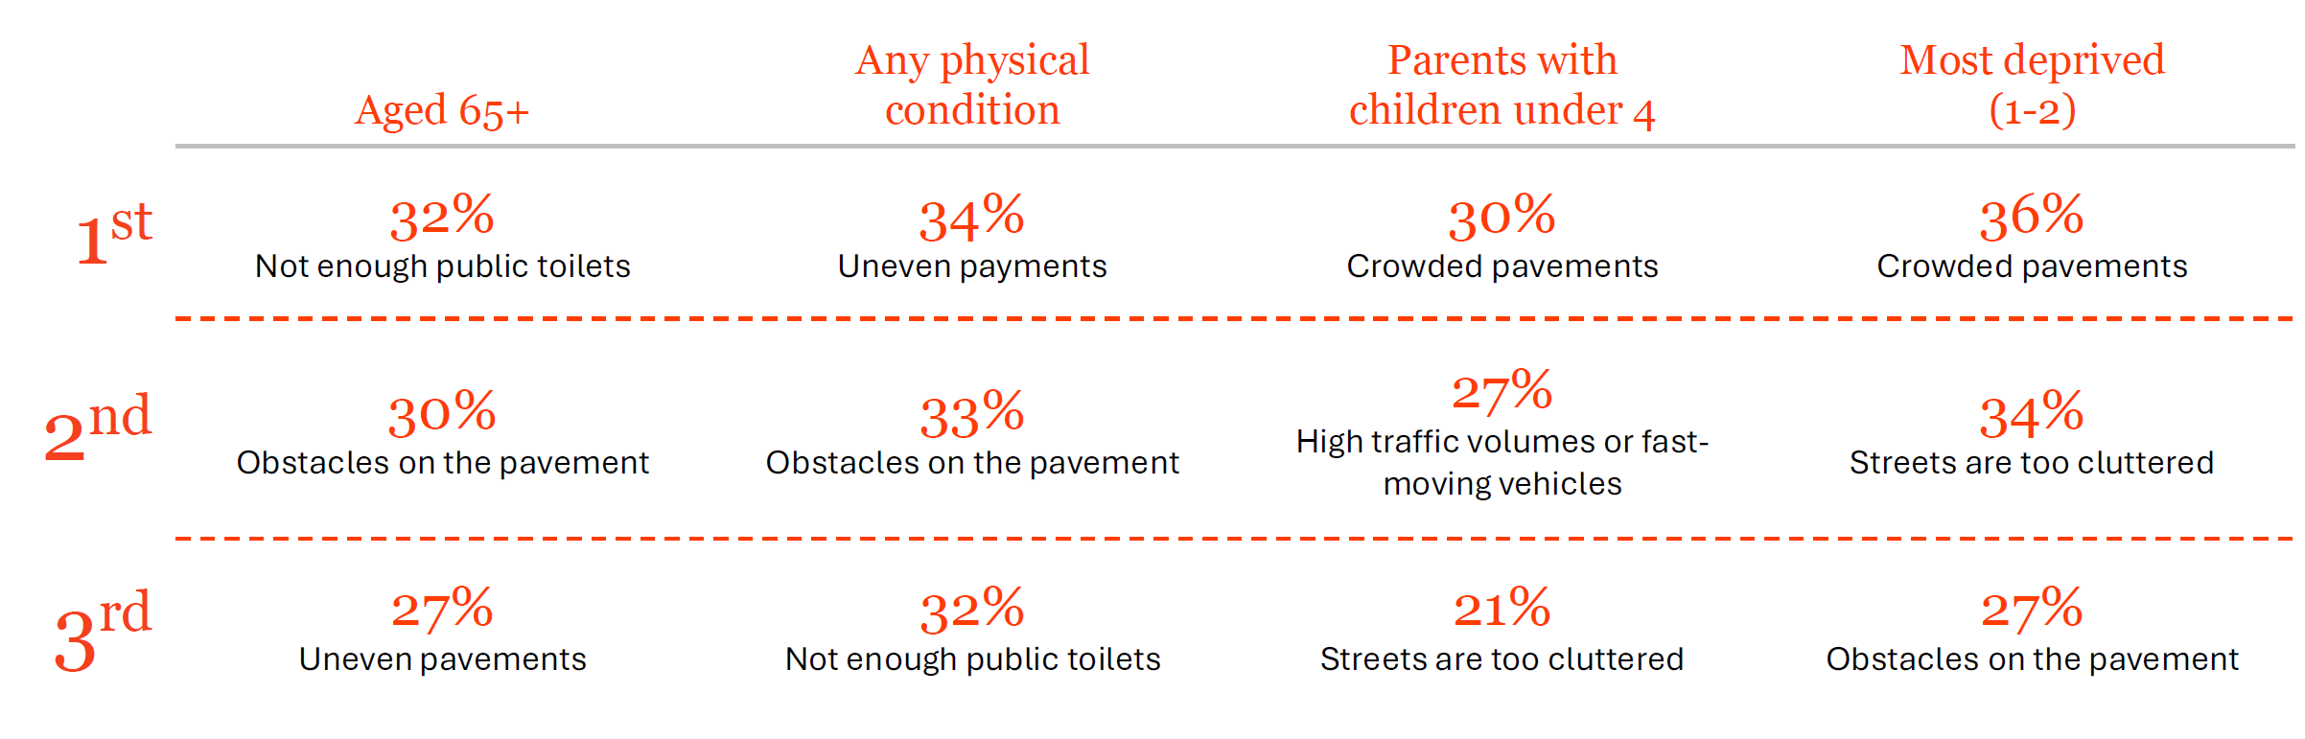
Top 3 reasons preventing more frequent walking / wheeling in London across key audiences
Crowded pavements are the top barrier for parents with children under 4 and deprived Londoners,
while older people and those with a physical condition highlight pavement quality and toilets
“
The most commonly reported barrier to walking and wheeling, in terms of London street space, is the quality of pavements. The provision of things like drop kerbs and tactile paving cause barriers that can in a lot of cases completely shut disabled people out from certain areas or opportunities because the streetscape is just really inaccessible.
Transport for All

Slide 15
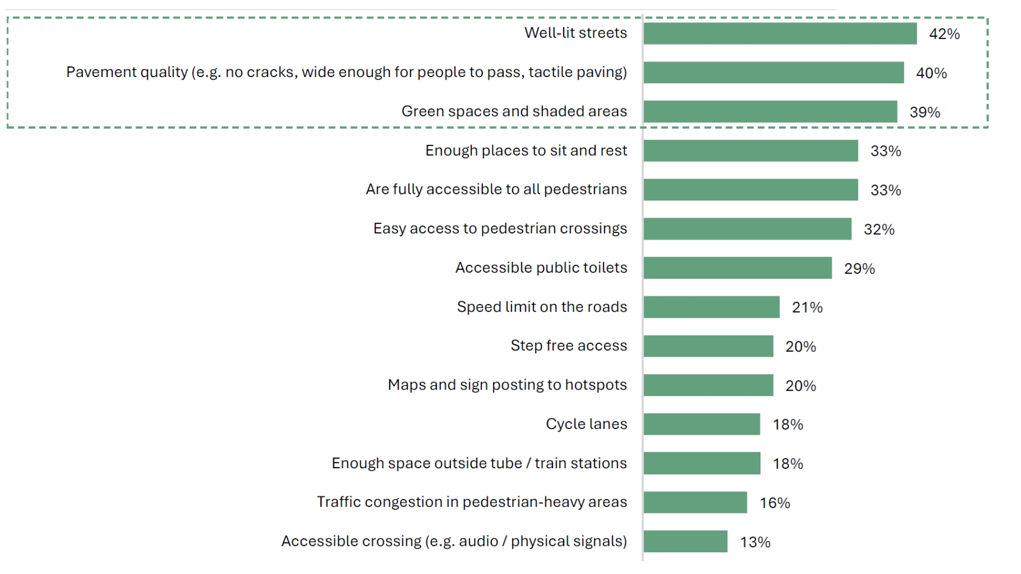
Most important factors for making streets work well for walking /wheeling in London
Well-lit streets, good pavements and green spaces are seen a the most important factors for making
London’s streets work well for walking/wheeling
Those aged 65+ are more likely to feel
green spaces (56%) and accessible
public toilets (43%) are more
important factors
“
We need more spaces where people can just walk on the street, and there’re benches
and there's greenery. Those aspects are important. It would help people get out
more and be more active.
Even walking around the block - that can already make so much physical difference, mentally as well.
London Councils

Slide 16
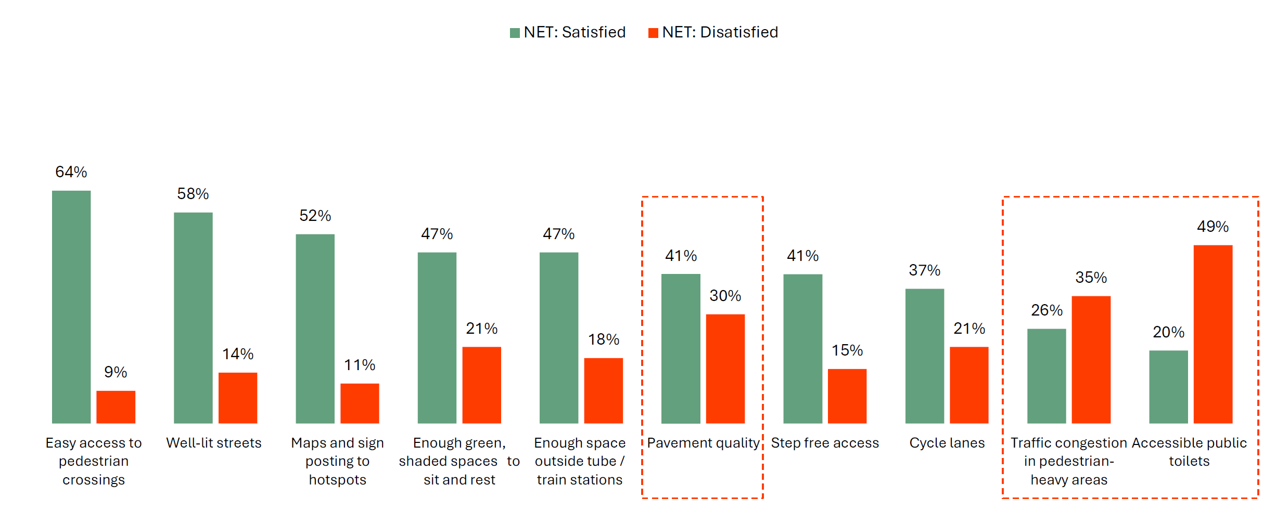
Satisfaction with specific street features – Total sample
A majority are satisfied with crossings and street lighting. However, public toilet accessibility, pavement quality and traffic congestion draw the most dissatisfaction

Slide 17
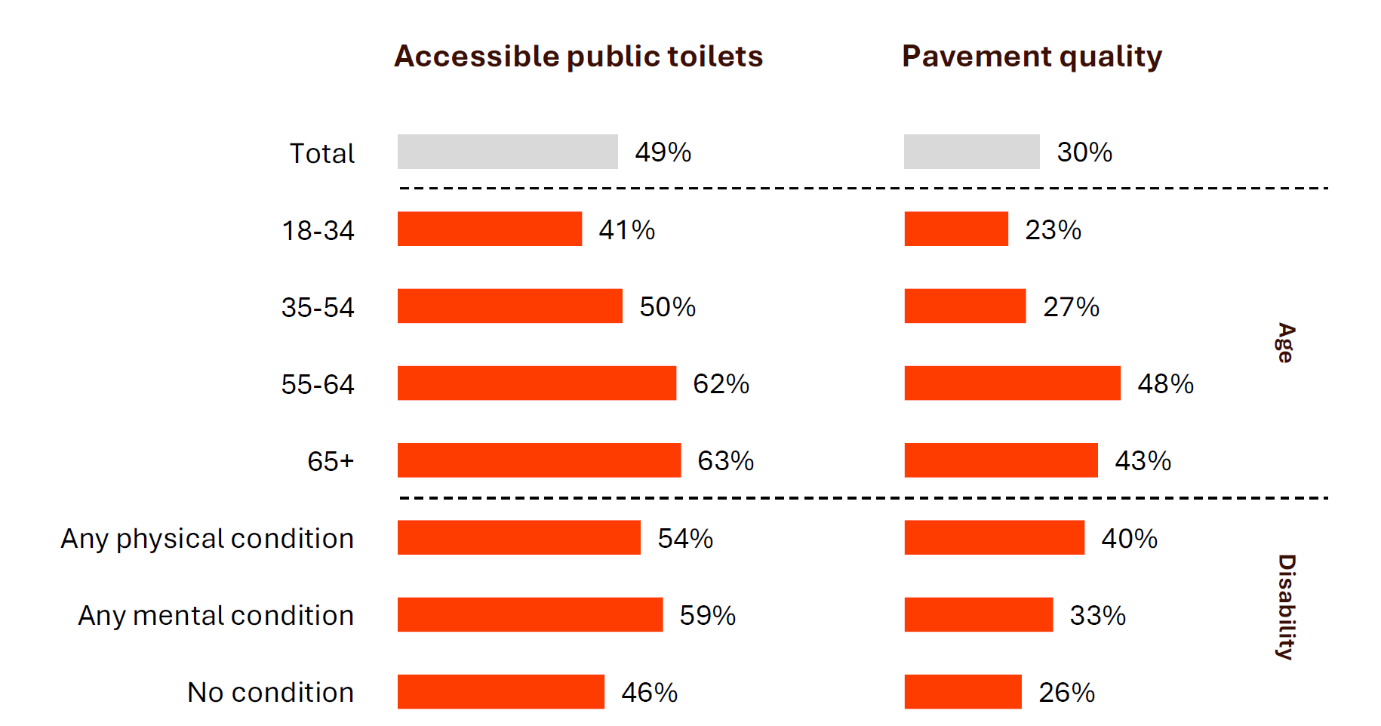
Net: Dissatisfied with specific street features
Older and disabled Londoners are most dissatisfied with public toilet access and pavement quality
“
We looked at the provision of accessible toilets in our report for prioritising funding of resources, because that was something that disabled people fed back which could really make or break a decision for them of where they travel.
Transport for All

Slide 18
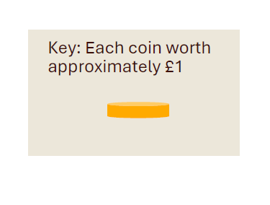
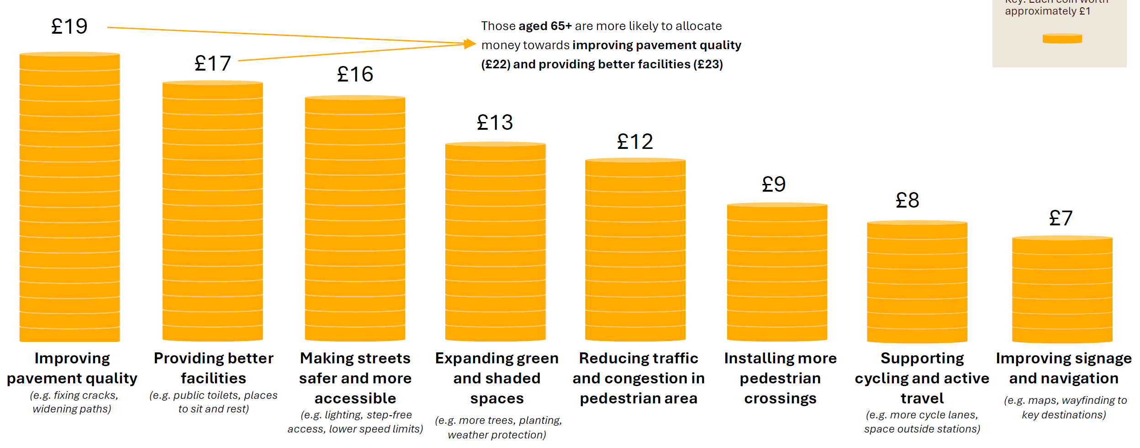
Money allocation task – How Mayor should divide budget (Mean score)
Pavement quality tops Londoners’ priorities for street investment, followed by providing better
facilities and making them safer and more accessibility

Slide 19
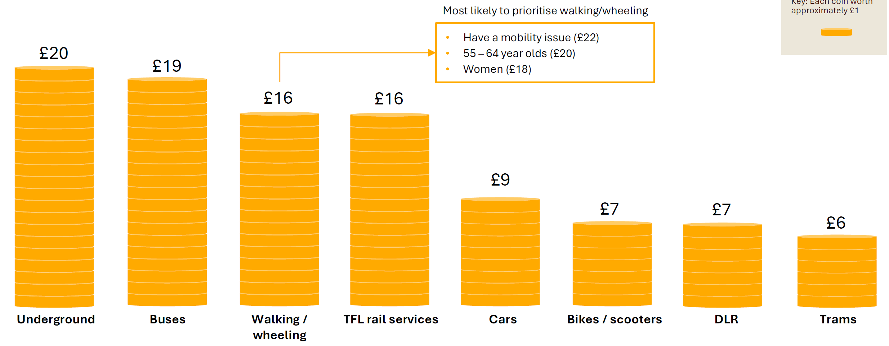
Money allocation task – How Mayor should divide budget (Mean score)
Public transport leads where Londoners want future investment from the Mayor, but walking/
wheeling are seen as a core part of the city’s transport future

Slide 20
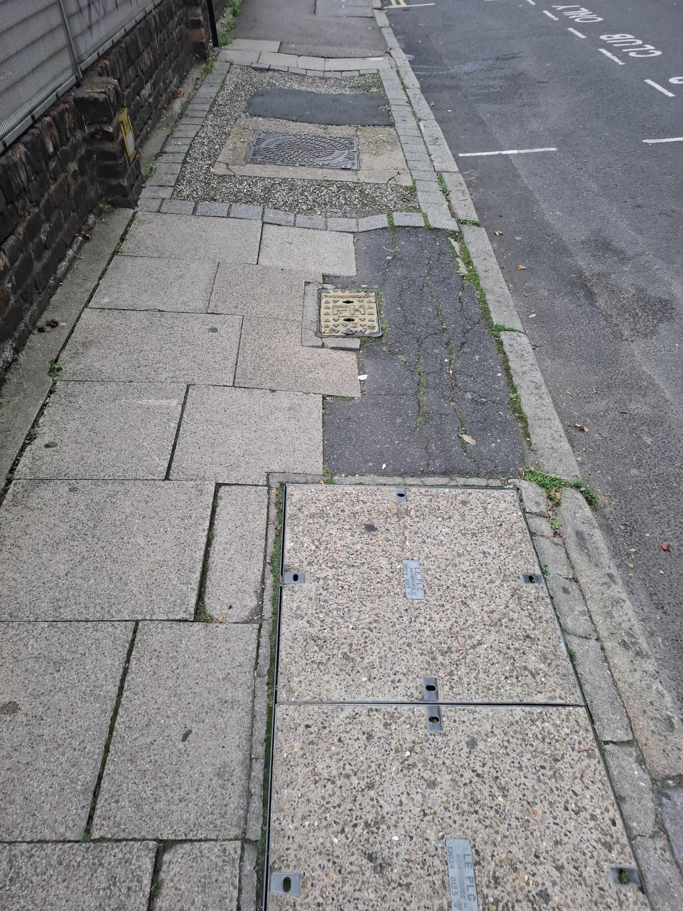

Our recommendations
Improving overall pavement quality and facilities to make streets safer and more accessible
Steps to repair damaged or uneven pavements, expand public toilet provision and seating, and add
accessibility features like tactile paving and dropped kerbs (including at crossings and busy junctions)
can all make for a better journey.
Co-designing street spaces with different groups to make sure they work for everyone
This includes working with groups most affected by changes, particularly those with additional accessibility requirements including disabled people, older adults and parents.
Working between TfL, boroughs and businesses to remove unnecessary obstacles to reduce barriers to walking and wheeling
This includes things like A-boards and e-bikes on pavements, and only placing things like bins, benches and micromobility infrastructure in places where they will not impede or narrow the sidewalk for pedestrians.
Better use of available funding to focus on Londoners’ priorities for improvement
Consistent, longer term and focused funding can help give local authorities the tools they need to more effectively plan and implement the measures needed to improve London’s streets.

Slide 21
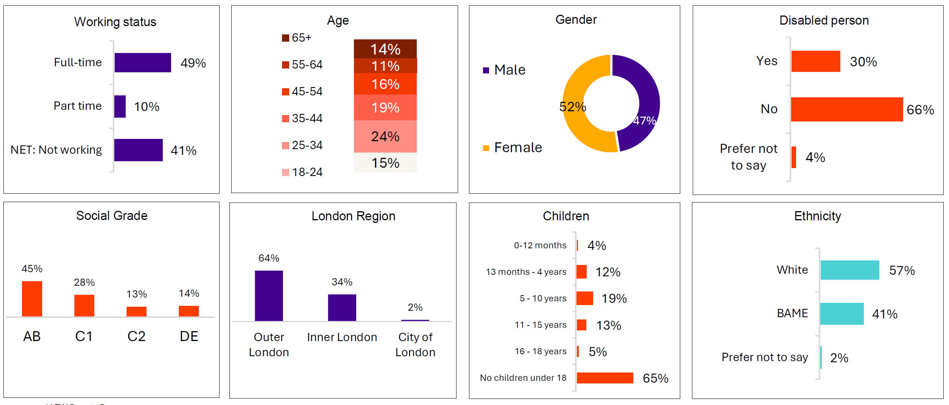
Profile of the quantitative respondents

Slide 22
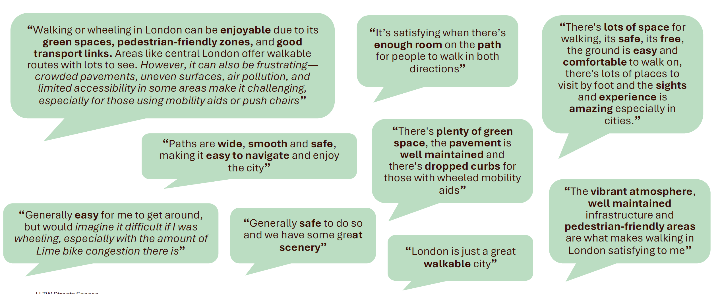
While many are satisfied with walking and wheeling in London, they are aware of ways to improve the streets in London further and can see how others may find it dissatisfying – particularly those with mobility aids

Slide 23
Thank you

